Slide 1


CAPSTONE PROJECT
Superstore Dashboard Analytics using power BI
Presented By
Student Name: Sudhanshu ranjan
College Name: Gaya college of engineering
Department: CSE
Email ID: Sudhanshuranjan9102@gmail.com

Slide 2
OUTLINE:
Problem Statement (Should not include solution)
Proposed System/Solution
System Development Approach (Technology Used)
Algorithm & Deployment
Result (Output Image)
Conclusion
Future Scope
References

Slide 3
Problem Statement:
Retail businesses generate a large amount of sales data daily. However, raw data alone is difficult to understand and analyze. Without proper visualization tools, it becomes challenging to identify trends, analyze product performance, and evaluate regional sales. Therefore, there is a need for a system that can convert raw sales data into meaningful insights for better decision-making.

Slide 4
Proposed Solution:
The proposed system aims to address the challenge of predicting the required bike count at each hour to ensure a stable supply of rental bikes. This involves leveraging data analytics and machine learning techniques to forecast demand patterns accurately. The solution will consist of the following components:
Data Collection:
Gather historical data on bike rentals, including time, date, location, and other relevant factors.
Utilize real-time data sources, such as weather conditions, events, and holidays, to enhance prediction accuracy.
Data Preprocessing:
Clean and preprocess the collected data to handle missing values, outliers, and inconsistencies.
Feature engineering to extract relevant features from the data that might impact bike demand.
Machine Learning Algorithm:
Implement a machine learning algorithm, such as a time-series forecasting model (e.g., ARIMA, SARIMA, or LSTM), to predict bike counts based on historical patterns.
Consider incorporating other factors like weather conditions, day of the week, and special events to improve prediction accuracy.
Deployment:
Develop a user-friendly interface or application that provides real-time predictions for bike counts at different hours.
Deploy the solution on a scalable and reliable platform, considering factors like server infrastructure, response time, and user accessibility.
Evaluation:
Assess the model's performance using appropriate metrics such as Mean Absolute Error (MAE), Root Mean Squared Error (RMSE), or other relevant metrics.
Fine-tune the model based on feedback and continuous monitoring of prediction accuracy.
Result:

Slide 5
System Approach:
The "System Approach" section outlines the overall strategy and methodology for developing and implementing the rental bike prediction system. Here's a suggested structure for this section:
System requirements
Library required to build the model

Slide 6
Algorithm & Deployment:
In the Algorithm section, describe the machine learning algorithm chosen for predicting bike counts. Here's an example structure for this section:
Algorithm Selection:
Provide a brief overview of the chosen algorithm (e.g., time-series forecasting model, like ARIMA or LSTM) and justify its selection based on the problem statement and data characteristics.
Data Input:
Specify the input features used by the algorithm, such as historical bike rental data, weather conditions, day of the week, and any other relevant factors.
Training Process:
Explain how the algorithm is trained using historical data. Highlight any specific considerations or techniques employed, such as cross-validation or hyperparameter tuning.
Prediction Process:
Detail how the trained algorithm makes predictions for future bike counts. Discuss any real-time data inputs considered during the prediction phase.

Slide 7
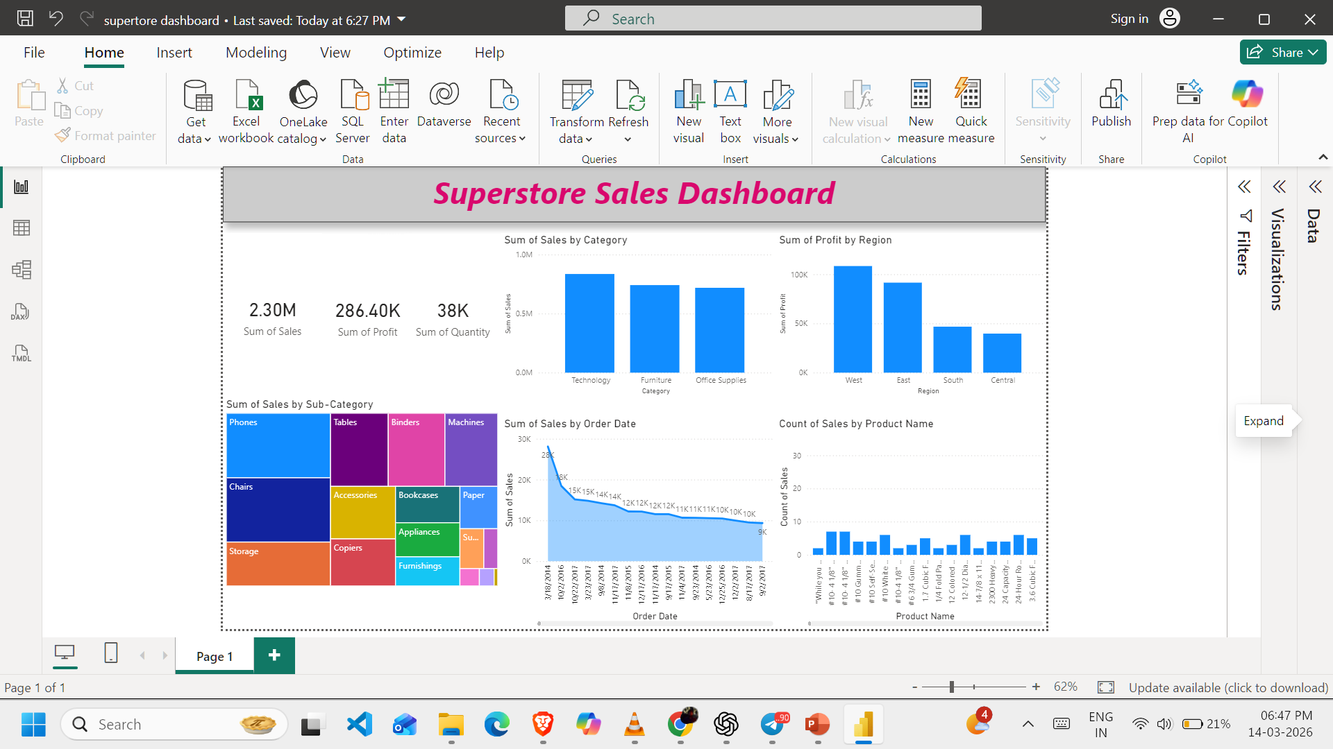
Result: The developed dashboard successfully visualizes sales and profit data of the Superstore dataset.

Slide 8
Conclusion:
The Power BI dashboard provides a clear visualization of sales performance and business trends. It helps identify profitable regions, high-performing product categories, and sales patterns over time. This project demonstrates how data visualization tools can transform raw business data into meaningful insights that support decision-making.

Slide 9
Future scope:
The project can be improved in the future by:
Integrating real-time sales data
Applying machine learning models for sales prediction
Connecting dashboards with cloud databases
Adding advanced analytics using Python or R
Developing mobile-friendly dashboards

Slide 10
References:
Microsoft Power BI Documentation
Superstore Sales Dataset
Online resources on data visualization techniques
Tutorials and learning materials related to Power BI
GitHub Link: Link

Slide 11
Thank You

